Slide 1
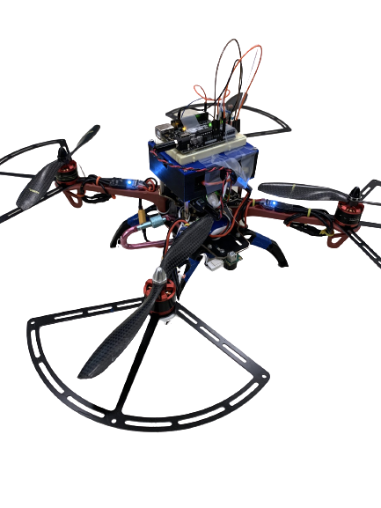

Quadcopter Research and Development
Sunset Industries: Chris Van Dyke, Samuel Hofmann, Hassan Kadiri, Engineers in Training
December 5th, 2020
Notes:
Chris

Slide 2
Introduction
Background:
Ariadne de Bothezat, a client who is planning to develop and market quadcopter platforms and sensor-electronic kits to enthusiasts and universities. This client is interested to learn every detail of our current prototypes.
Task Statement:
Introduce our client, Ms. Bothezat, to our autonomous quadcopters.
Show how our quadcopter performed in a maze and introduce our team-designed light-intensity sensor.
Purpose:
To give Ms. Bothezat a better understanding of autonomous quadcopters’ functionalities
To demonstrate our quadcopter prototype to Ariadne
Notes:
Chris

Slide 3
Presentation Overview
Part 1: PID and Maze Traversal
System Overview
Function of the Device
Technical Specifications
Future Considerations
Part 2: Custom Project
System Overview
Function of the Device
Technical Specifications
Future Considerations
Conclusion
Notes:
Chris

Slide 4
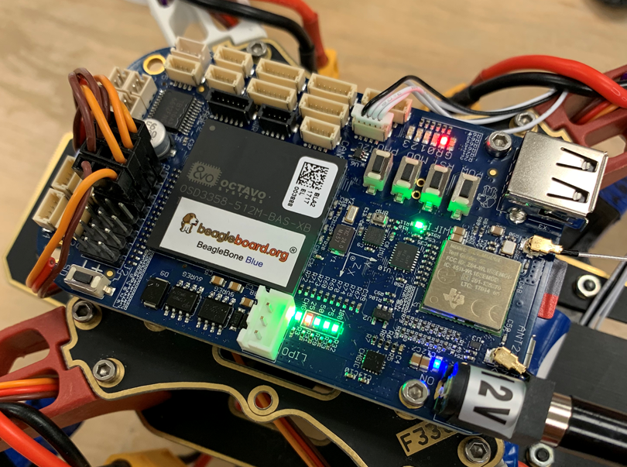
Part 1: PID and Maze Traversal
Notes:
Sam

Slide 5
Overview of Autonomous Quadcopter System
LIDAR Sensor Enclosure
Motor and Propeller (Sample,4)
Plastic Frame
BeagleBone Blue
Downward-facing Ultrasonic Sensor
Notes:
Sam

Slide 6
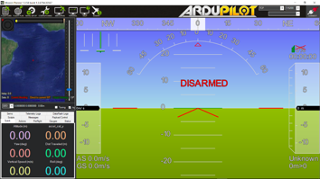
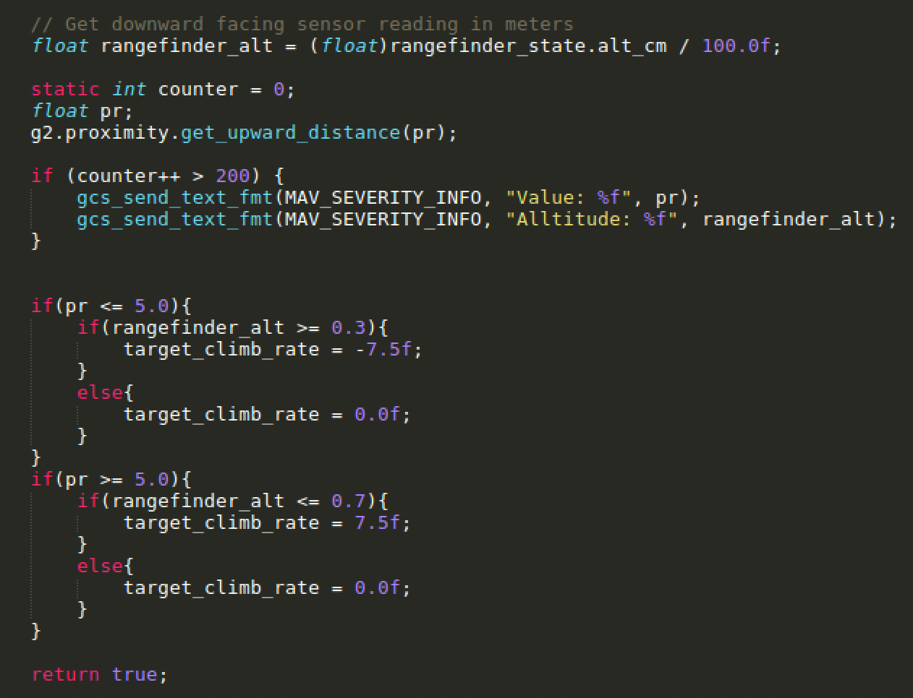
Overview of Autonomous Quadcopter System
Mission Planner Sublime Text Editor
Flight data
Visual Representation of Flight Axes
Sample Code
Notes:
Sam

Slide 7
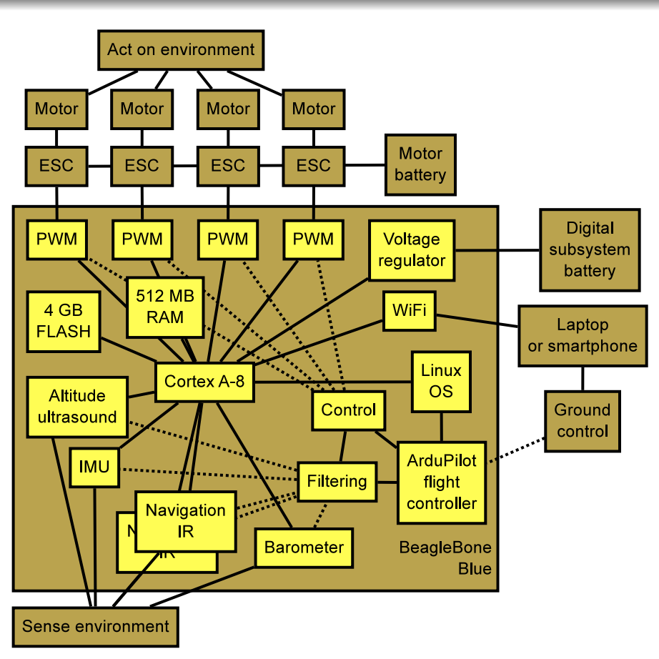
Overview of Autonomous Quadcopter System
Solid Line: Physical Relationship
Lidar Sensor
Lidar Sensor
Lidar Sensor
Dotted Line: Functional Relationship
Lidar Sensor
Lidar Arduino
Lidar Sensor Block chart
BeagleBone Blue Block chart ^{[1]}
Notes:
Hassan

Slide 8

Obstacle Course Traversal Video
Notes:
Hassan

Slide 9
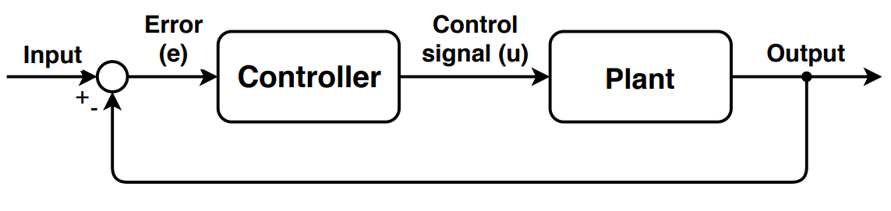
PID Controller Overview
Stands for proportional–integral–derivative control
Calculates output (u) based on error (e)
Error = Desired - Actual
Notes:
Sam

Slide 10
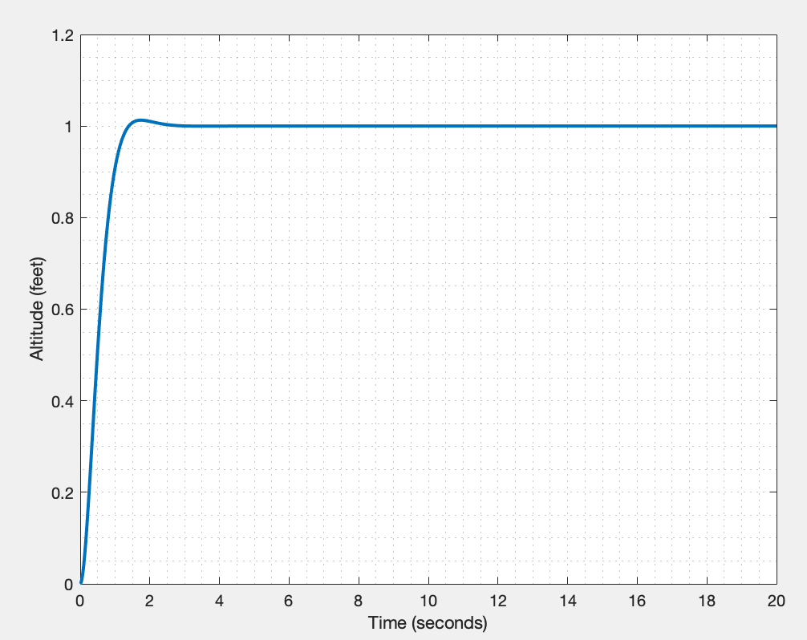
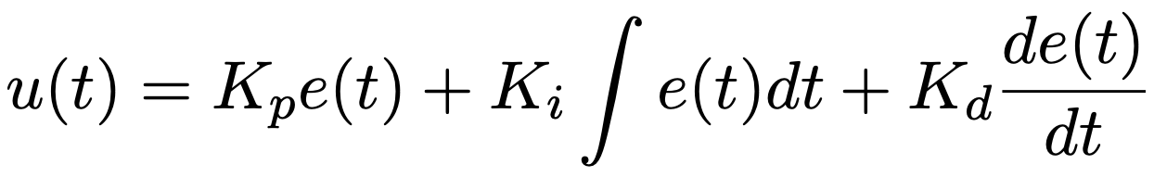
PID Controller on Quadcopter
Proportional-Integral-Derivative
Error = Desired - Actual
Maximizes speed of a system
Minimizes overshoot
Altitude vs Time Graph
PID control equation
Notes:
Sam

Slide 11
Technical Specifications: PID
Mission Planner Parameters
 | Roll | Pitch
Proportional Constant | 0.9 | 0.9
Integral Constant | 0.3 | 0.3
Derivative Constant | 0.6 | 0.6
Table 1: Roll and pitch PID values
High P and D
Low I
Notes:
Sam

Slide 12
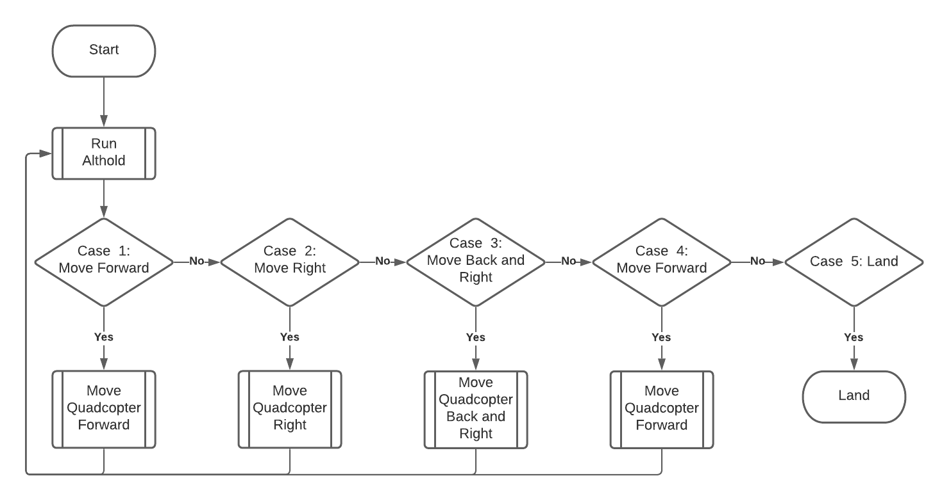
Maze Code Flowchart
control_autonomous.cpp flowchart
Notes:
Hassan

Slide 13
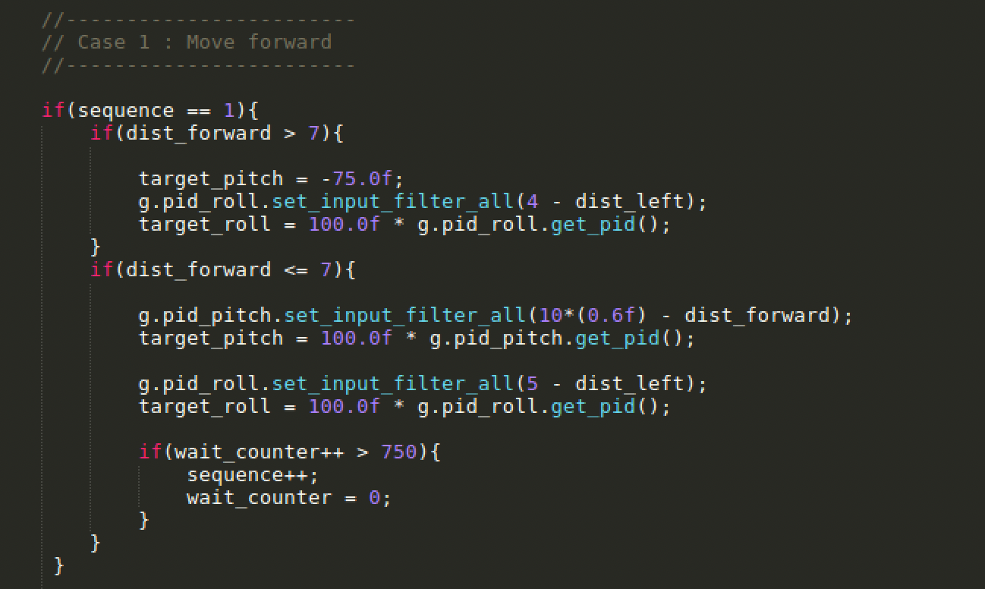
Technical Specifications: Code
Runs During First Section of Maze
Move Forward Until Close to Wall
Stabilize near front wall
Increment to Next Section of Maze
Sample control_autonomous.cpp Code ^{[3]}
Notes:
Hassan

Slide 14
Future Development
Alter code to improve stability
Landing and back right corner
Improve the speed of the system
Takes 44 seconds to finish maze
Increase pitch/roll values from 0.75°
Reduce buffer time from 5 seconds
Notes:
Hassan

Slide 15
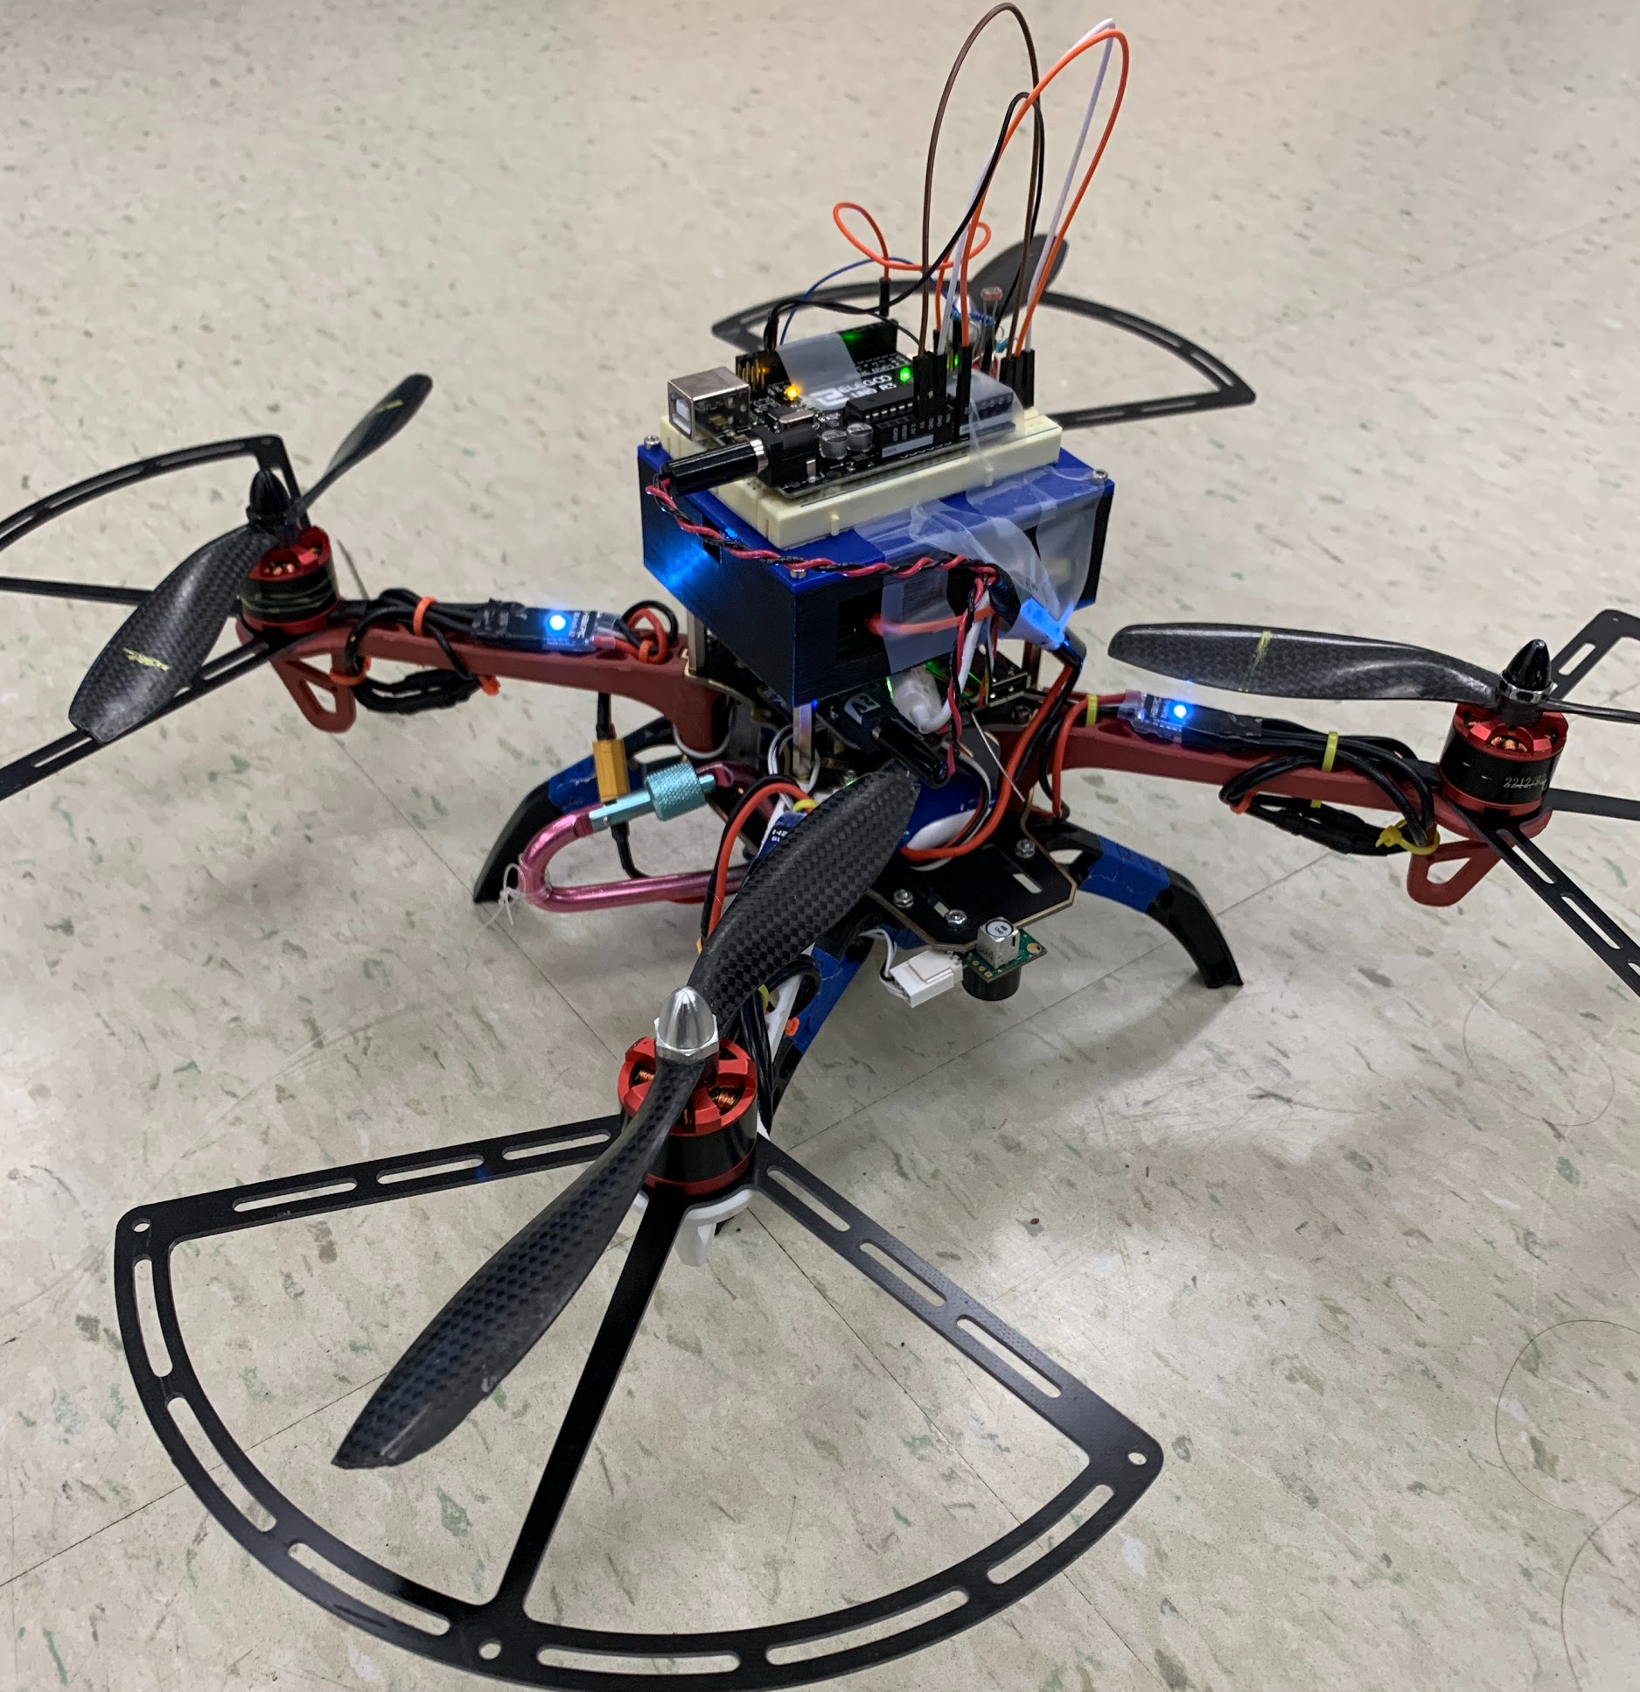
Part 2: Custom Project
Notes:
Chris

Slide 16
Overview: Mission of Custom Project
Add a new sensor to quadcopter
Detect the nearby light intensity
Interface the new sensor with BeagleBone
Adjust altitude based on sensor readings
Notes:
Chris

Slide 17
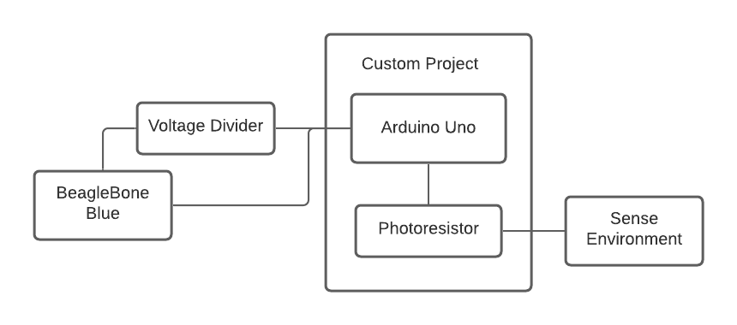
Overview: Flowchart
Notes:
Chris

Slide 18
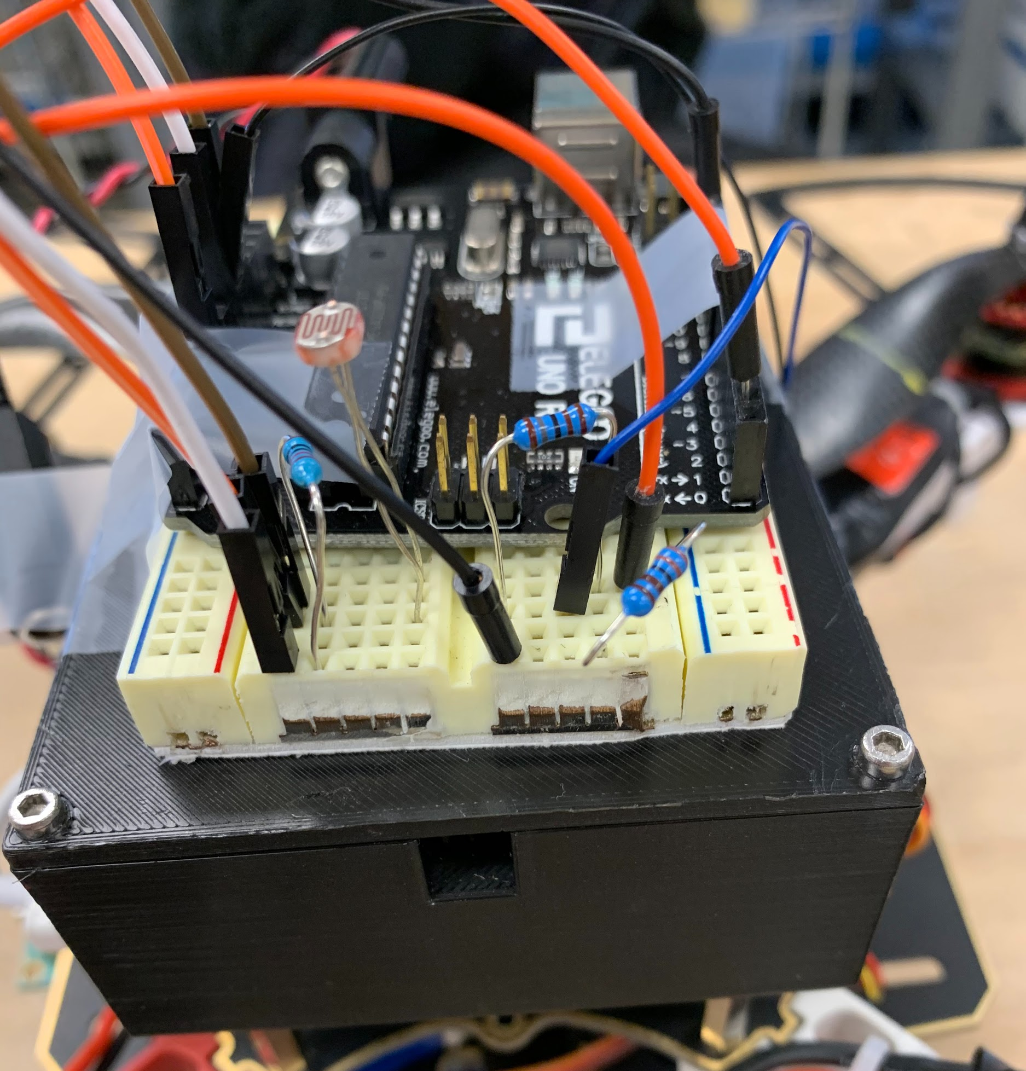
Overview: Custom Project Hardware
Additional Arduino Uno
Wires to BeagleBone
Photoresistor
Resistor (Sample, 3)
Photoresistor Circuit
Voltage Diverter
Circuit
Notes:
Chris

Slide 19
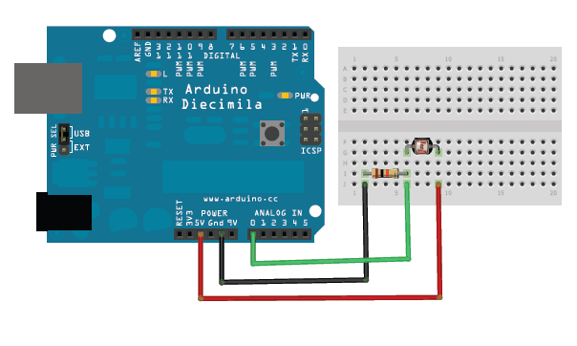
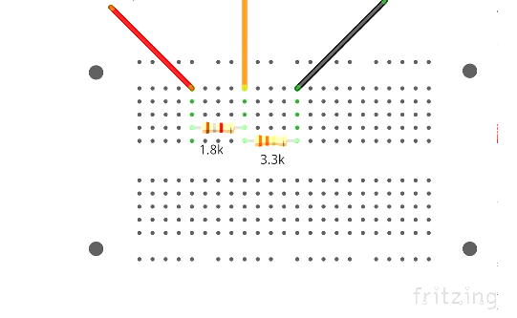
Electronics Diagrams
BeagleBone Rx pin
Arduino Tx pin
Ground
Photoresistor Circuit ^{[2]}
Voltage Splitter Circuit
Notes:
Chris

Slide 20
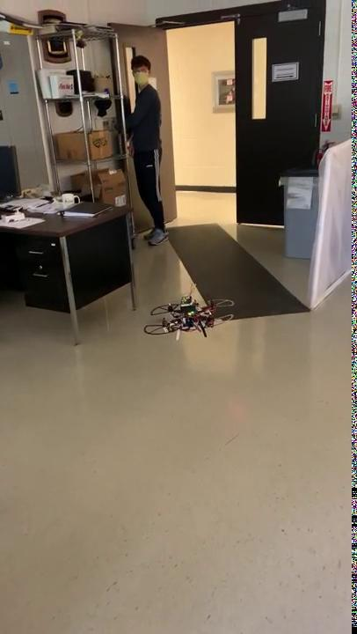
Custom Project Video
Notes:
Chris

Slide 21
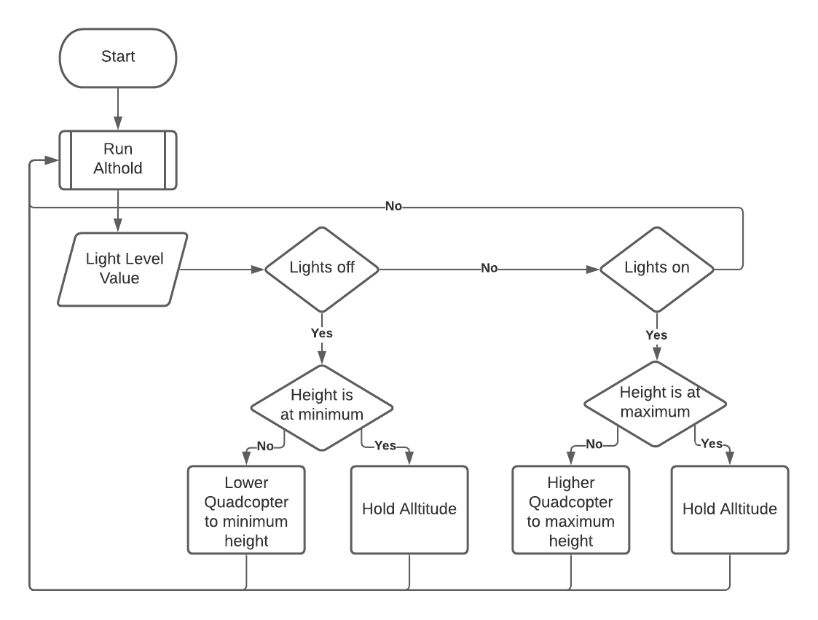
Project Code Flowchart
Notes:
Hassan

Slide 22
Technical Specifications: Code
Receives data
Prints information
Moves quadcopter downwards when lights are off
Moves quadcopter upwards when lights are on
Code Snipped From control_autonomous.cpp ^{[3]}
Notes:
Hassan

Slide 23
Future Developments
Improve light fluctuation response
Fully land/takeoff
Integrate adaptability for different lighting environments
Inside vs outside
Construct enclosure for added hardware on drone
Notes:
Sam

Slide 24
Conclusion
Autonomous quadcopters are adaptable
Coding/computer science focus (maze)
Electronics/hardware focus (custom project)
Hardware and code have many possibilities
Project applicable in educational settings
Notes:
Sam

Slide 25

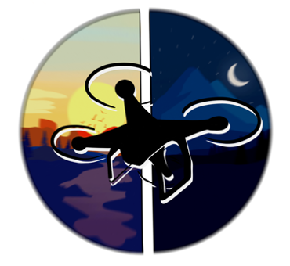
Questions?
Chris Van Dyke: chvd@umich.edu
Sam Hofmann: sammann@umich.edu
Hassan Kadiri: hekadiri@umich.edu
Notes:
Hassan

Slide 26
References
[1] Engineering 100 Technical Lecture 1
[2] Photoresistor Circuit Schematic
[3] All Code and Videos

